Slide 1

CYZ’S SPORT EXERCISES
~~~

Slide 2
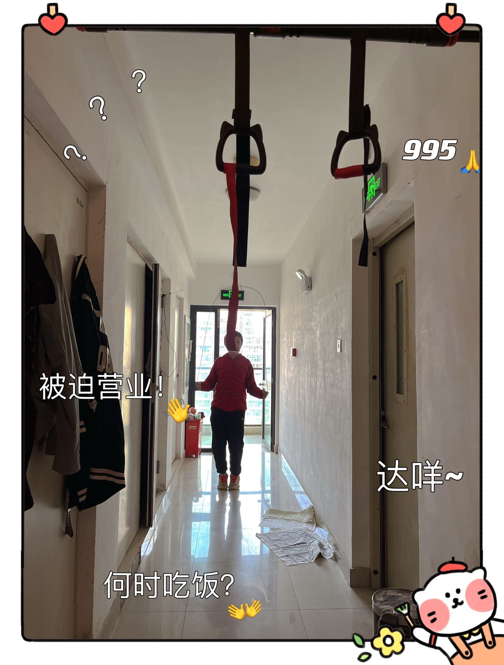

Slide 3
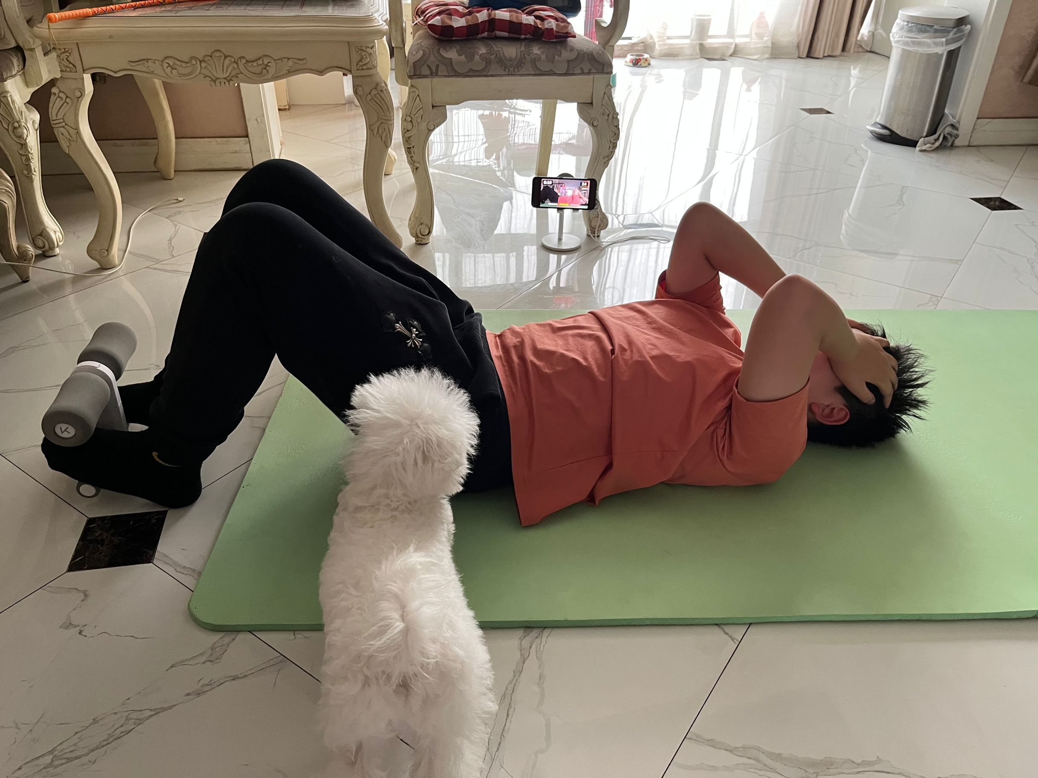
空白演示
单击输入您的封面副标题

Slide 4
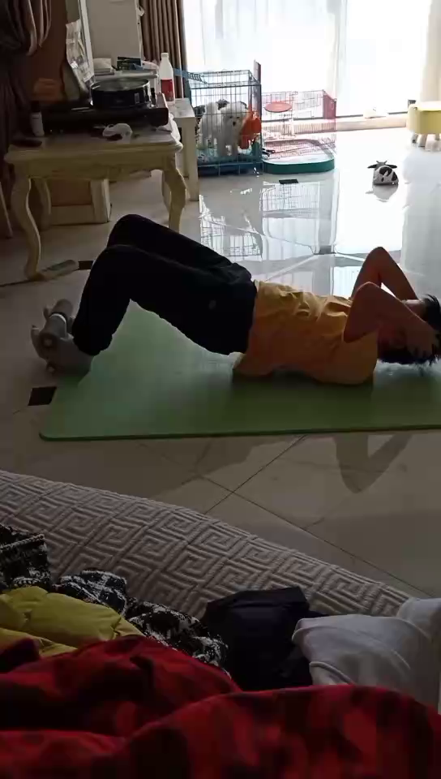

Slide 5
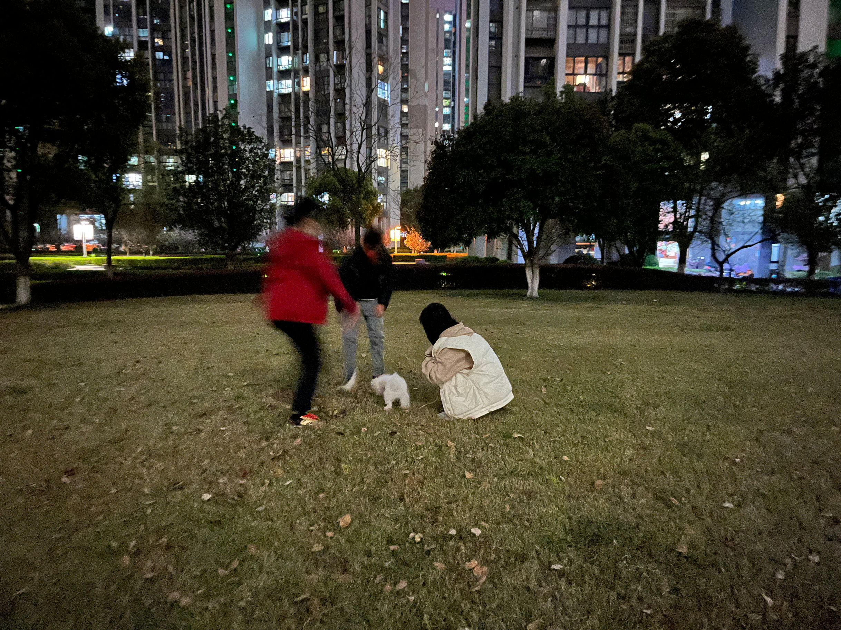

Slide 6
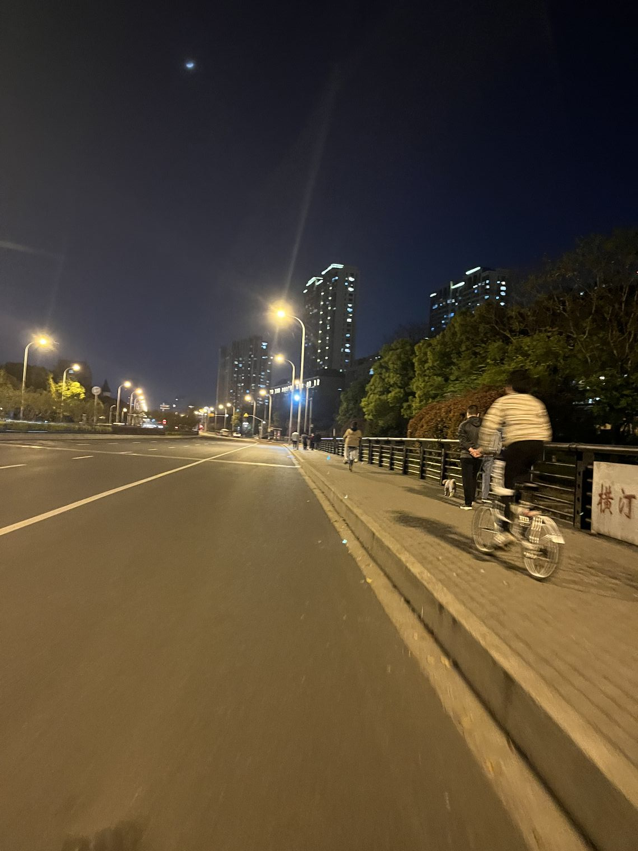

Slide 7


Slide 8
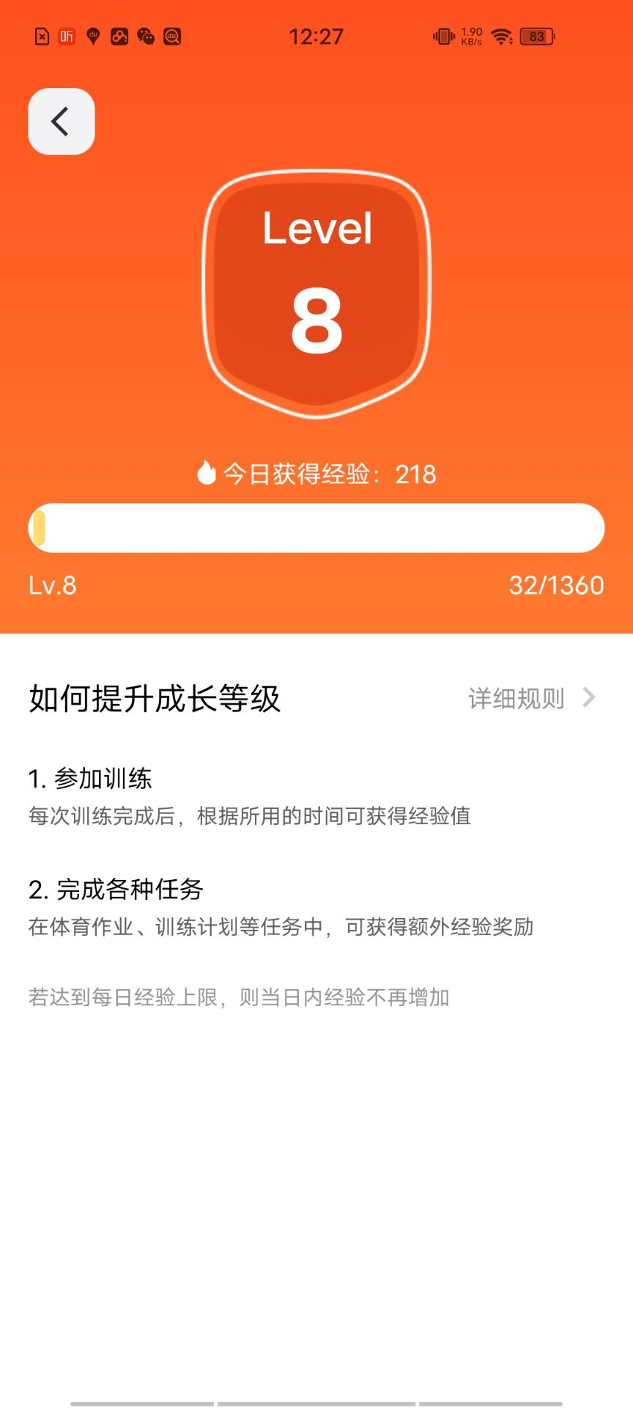

Slide 9
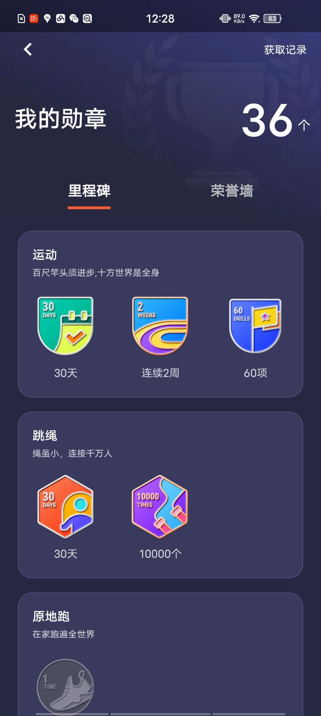

Slide 10


Slide 12
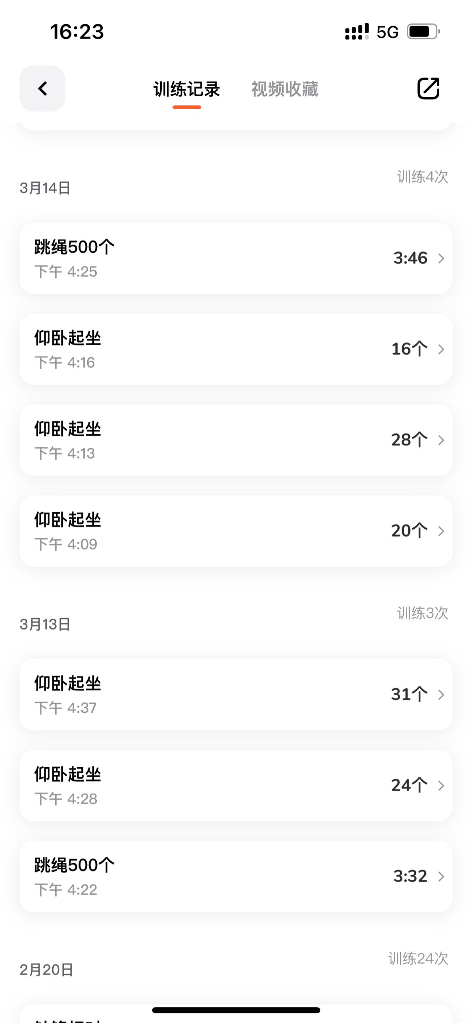

Slide 13


Slide 14
thank you
thank you
thank you
thank you
thank you
thank you
thank you
thank you
thank you
thank you
thank you
thank you
thank you
thank you
thank you
thank you
thank you
thank you
thank you
thank you
thank you
thank you
thank you
thank you
thank you
thank you
thank you
thank you
thank you
thank you
thank you
thank you
thank you
thank you
thank you
thank you
thank you
thank you
thank you
thank you
thank you
thank you
thank you
thank you
thank you
thank you
thank you
thank you
thank you
thank you
thank you
thank you
thank you
thank you
thank you
thank you
thank you
thank you
thank you

